Slide 1


ABB FIA Formula E Championship
Staff coronavirus Awareness
Safety Briefing (corvid 19)_v3
Richard Bate - February 2020

Slide 2
Coronavirus Awareness:
On 31st December 2019, the WHO was alerted to several cases of pneumonia in Wuhan City, Hubei Province of China. The virus did not match any other known virus. One week later, on 7 January, Chinese authorities confirmed that they had identified a new virus. The new virus is a coronavirus, which is a family of viruses that include the common cold, and viruses such as SARS and MERS. This new virus was temporarily named “2019 - nCoV.”
2019 Novel Coronavirus (2019-nCoV) is a virus (more specifically, a coronavirus) identified as the cause of an outbreak of respiratory illness first detected in Wuhan, China. Early on, many of the patients in the outbreak in Wuhan, China reportedly had some link to a large seafood and animal market, suggesting animal-to-person spread. However, a growing number of patients reportedly have not had exposure to animal markets, suggesting person-to-person spread is occurring. At this time it’s unclear how easily or sustainably this virus is spreading between people, however the spread is now pan-global.
The situation is evolving rapidly and persons living, working, traveling in high risk settings are encouraged to check with local health authorities for the most up to date guidance.
Richard Bate - February 2020

Slide 3
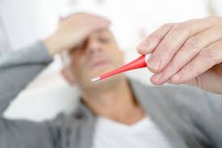
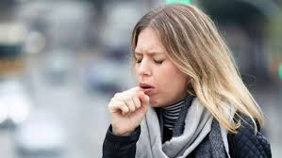
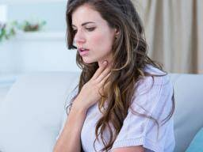
Symptoms:
Patients with confirmed 2019-nCoV infection have reportedly had mild to severe respiratory illness with symptoms of but not exclusively: fever, cough, shortness of breath, headaches and occasionally – nausea.
Fever over 38 C Cough Shortness of breath
CDC believes at this time that symptoms of 2019-nCoV may appear in as few as 2 days or as long as 14 days after exposure.
Richard Bate - February 2020

Slide 4
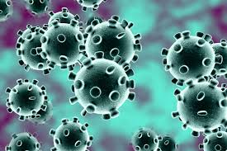
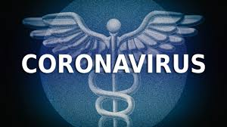
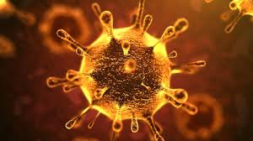
Transmission:
Coronaviruses are a large family of viruses that are common in many different species of animals, including camels, cattle, cats, and bats. Rarely, animal coronaviruses can infect people and then spread between people such as with MERS and SARS. Many of the patients in the pneumonia outbreak caused by 2019-nCov in Wuhan, China had some link to a large seafood and live animal market, suggesting animal-to-person spread. However, a growing number of patients reportedly have not had exposure to animal markets, indicating person-to-person spread is occurring.
When person-to-person spread has occurred with MERS and SARS, it is thought to have happened via respiratory droplets produced when an infected person coughs or sneezes, similar to how influenza and other respiratory pathogens spread. It’s not clear yet how easily 2019-nCoV spreads from person-to-person. It’s important to know this in order to better understand the risk associated with this virus.
Richard Bate - February 2020

Slide 5

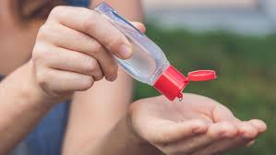
Prevention:
There is currently no vaccine to prevent 2019-nCoV infection. The best way to prevent infection is to avoid being exposed to this virus.
The U.S. CDC recommends avoiding non-essential travel to Wuhan, China and other effected areas
Chinese officials have closed transport within and out of Wuhan, including buses, subways, trains, and the airport.
Avoid contact with sick people.
Avoid animals (alive or dead), animal markets, and products that come from animals (such as uncooked meat).
Wash hands often with soap and water for at least 20 seconds. Use an alcohol-based hand sanitizer if soap and water are not available.
If in a high- risk setting, consider wearing a surgical mask or N95 type respirator to help minimize exposure risk. Check with local health authorities for specific guidance. You may also wish to disinfect common surfaces (e.g. shared phones, laptops, desks) prior to use.
Richard Bate - February 2020

Slide 6


Prevention:
If you traveled to China or other effected counties including South Korea and northern Italy in the last 14 days and feel sick with fever, cough, or difficulty breathing, you should:
Seek medical care right away. Before you go to a doctor’s office or emergency room, call ahead and tell them about your recent travel and your symptoms.
Avoid contact with others.
Do Not travel or go to work while sick.
Cover your mouth and nose with a tissue or your sleeve (not your hands) when coughing or sneezing.
Wash hands often with soap and water for at least 20 seconds. Use an alcohol-based hand sanitizer if soap and water are not available.
Richard Bate - February 2020

Slide 7
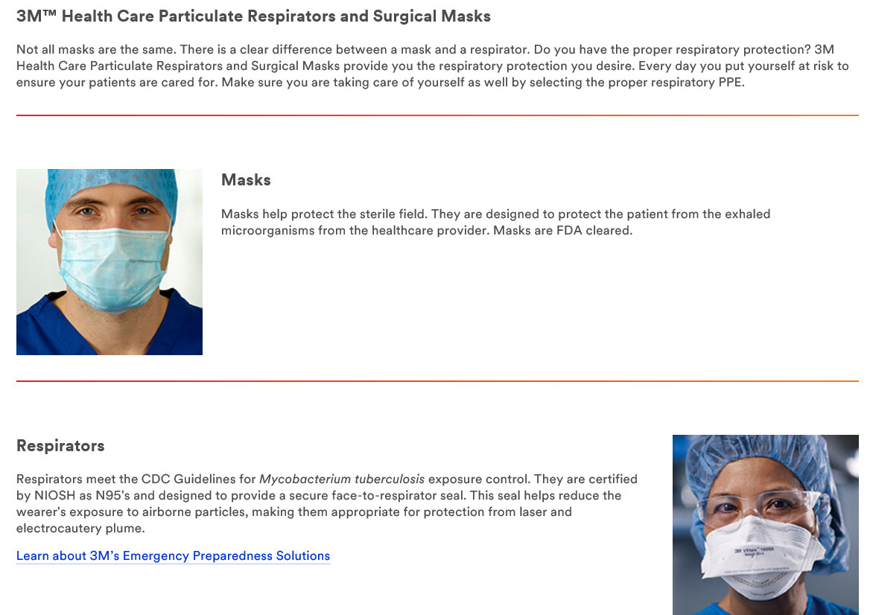
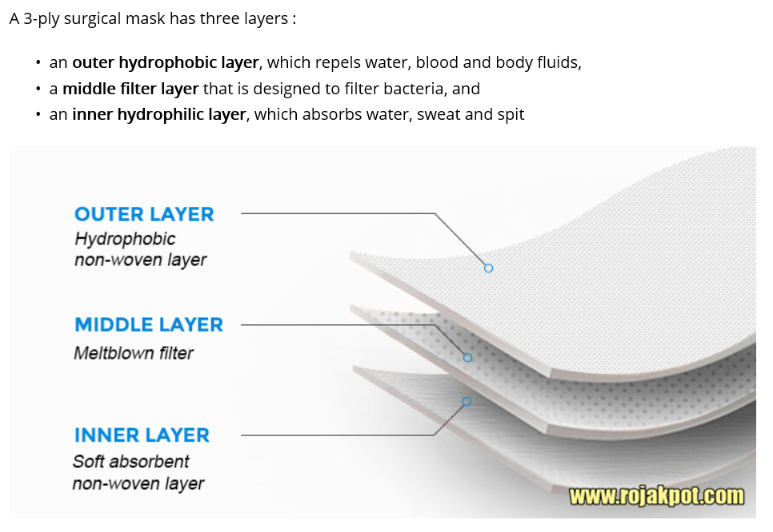
Use of Surgical Masks:
Richard Bate - February 2020

Slide 8
Treatment:
There is no specific antiviral treatment recommended for 2019-nCoV infection.
People infected with 2019-nCoV should call their GP to receive information on supportive care to help relieve symptoms.
For severe cases, treatment should include care to support vital organ functions.
People who think they may have been exposed to 2019-nCoV should contact their GP immediately.
Public Heath England advise that you should not attend an Emergency Dept or Drop-in Centre if your symptoms of the virus.
Self quarantine for 14 days has proved successful and remains current advice from Public Heath England.
Those based in the UK are advised to contact 111 NHS CV for advice if they believe they are symptomatic
Richard Bate - February 2020

Slide 9
UK GOV Travel Advice:
The Foreign & Commonwealth Office (FCO) is still advising against all travel to Hubei Province, and against all but essential travel to the rest of mainland China
The FCO is also advising against all but essential travel to the cities of Daegu and Cheongdo in South Korea
To ten small towns in the Lombardy region and one in the Veneto region of Italy
The FCO is not advising against travel to any other country/territory as a result of coronavirus risks.
Richard Bate - February 2020

Slide 10
Prevention:
Regular and frequent handwashing, and attention to respiratory hygiene is highly important in preventing the spread of the disease.
Wash your hands after, before, during and after food preparation.
Wash your hands after using the bathroom.
Wash your hands whenever hands are dirty.
Carry a hand sanitizer to use when hand washing facilities are not easily available.
Refraining from touching your face. If you must touch your face, only do so with clean hands.
Use a tissue to cover the nose and mouth when coughing or sneezing.
If a tissue is not available, it is preferable to cover the nose and mouth with the upper sleeve or inner elbow.
Do not blow your nose into your hands.
Dispose of used tissues in the nearest waste receptacle.
In common areas, try to stay 1-2 meters (3-6 feet) away from coughing individuals.
Richard Bate - February 2020

Slide 11
Formula E Action Plan
All travel to be approved by Line Managers and Human Resource Department.
Unnecessary travel to effected zones defined by WHO is suspended until further notice.
Where possible make conference calls using Bluejeans or Skype.
Coronavirus WhatsApp group to continue updating the group.
Daily updates via email to the Coronavirus group to continue.
Richard Bate - February 2020

Slide 12
Resources
Coronavirus (2020 -- nCoV) Specific Sites:
WHO https://www.who.int/emergencies/diseases/novel-coronavirus-2019
US CDC https://www.cdc.gov/coronavirus/2019-ncov/index.html
OSHA https://www.osha.gov/SLTC/novel_coronavirus/index.html
Global Case Map:
https://gisanddata.maps.arcgis.com/apps/opsdashboard/index.html#/bda7594740fd40299423467b48e9ecf6
Infection Control Guidance:
US CDC- Interim Guidance for Preventing 2019 Novel Coronavirus (2019-nCoV) from Spreading to Others in Homes and Communities: https://www.cdc.gov/coronavirus/2019-ncov/guidance-prevent-spread.html
WHO- Infection Control Precautions in Healthcare Settings: https://www.who.int/publications-detail/infection-prevention-and-control-during-health-care-when-novel-coronavirus-(ncov)-infection-is-suspected
Richard Bate - February 2020

